Slide 1




Implementation of Chatbot using NLP
AICTE Student ID: STU64cbfe79aad0c1691090553 AICTE Internship ID: INTERNSHIP_173070615967287aef12823

Slide 2

Learning Objectives
Learn how to preprocess and label data for intent and entity extraction.
Develop a Logistic Regression model to classify user intents based on input text.
Explore the integration of NLP models with a web interface using Streamlit.
Design an interactive chatbot interface to capture user input and provide appropriate responses.
Enhance problem-solving skills by building a real-world application with Python.
Gain insights into extending chatbot capabilities with advanced NLP and deep learning techniques.
Understand the fundamentals of Natural Language Processing (NLP) and its application in intent recognition.
GOAL
Source :
www.freepik.com/

Slide 3
Tools and Technology used
Python: Programming language for developing the chatbot.
Natural Language Processing (NLP): For text preprocessing, intent detection, and entity extraction.
Logistic Regression: Machine learning algorithm for classifying user intents.
Streamlit: Framework for building the interactive chatbot web interface.
Pandas: For data manipulation and preparation.
Scikit-learn: For implementing and training the Logistic Regression model.
NLTK/Spacy: Libraries for text tokenization, stemming, and lemmatization.
Streamlit Chat Components: For creating a dynamic chat interface.
Jupyter Notebook/IDE: For model development and testing.

Slide 4
Methodology
Dataset Preparation:
Collect labeled data containing user intents, entities, and input text.
Preprocess the data using NLP techniques (e.g., tokenization, stemming, lemmatization).
Model Development:
Extract features from text using methods like Bag of Words (BoW) or TF-IDF.
Train a Logistic Regression model on the labeled dataset for intent classification.
Test and evaluate the model using metrics such as accuracy and F1-score.
Chatbot Architecture:
Build a text-processing pipeline to handle user input dynamically.
Use the trained model to identify the user's intent and extract relevant entities.
Interface Design:
Design a user-friendly chatbot interface using Streamlit.
Create input fields for user text and a display area for chatbot responses.
Integrate the intent classification model with the Streamlit application.
Integration and Testing:
Connect the NLP model and interface to enable real-time interaction.
Conduct rigorous testing with various inputs to validate chatbot performance.
Deployment and Iteration:
Deploy the chatbot application using Streamlit sharing or a cloud platform.
Gather feedback and improve the chatbot by adding more intents or optimizing the model.

Slide 5
Problem Statement:
“In today’s digital age, providing instant and accurate responses to user queries is crucial for enhancing user experience across various domains. However, many existing chatbot solutions struggle to effectively understand user intent and extract relevant entities, leading to unsatisfactory interactions. This project aims to develop an NLP-based chatbot using Logistic Regression to accurately classify intents and extract entities from user input. By leveraging Streamlit, the project also seeks to create an intuitive and interactive web interface for seamless user interaction, bridging the gap between technical capability and user accessibility.”

Slide 6
Solution:
The proposed solution is an intent-based chatbot built using NLP techniques and a Logistic Regression model for intent classification and entity extraction. The solution is implemented in the following steps:
Intent Detection and Entity Extraction:
Use labeled datasets to train a Logistic Regression model for classifying user intents.
Implement NLP preprocessing techniques (e.g., tokenization, stemming) to process user input effectively.
Interactive Chatbot Interface:
Build an intuitive web-based interface using Streamlit to facilitate user interaction.
Integrate the trained model to process user inputs in real-time and generate appropriate responses.
Enhanced User Experience:
Display a dynamic chat window for smooth interaction between users and the chatbot.
Provide meaningful and accurate responses by leveraging the trained model and NLP techniques.
Scalability and Customization:
Allow for easy addition of new intents and entities to extend chatbot capabilities.
Enable integration with more advanced models and techniques, such as deep learning, for improved performance.
This solution bridges the gap between user expectations and chatbot performance, creating a reliable, scalable, and interactive conversational platform.

Slide 7
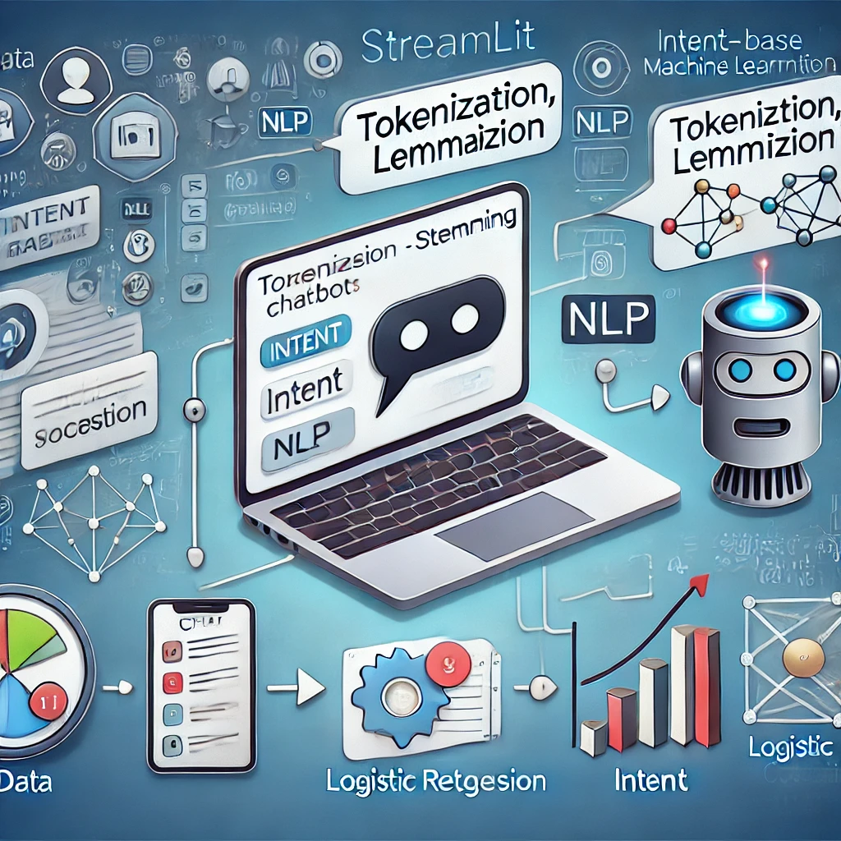
Conclusion:
This project successfully demonstrates the development of an intent-based chatbot using NLP and Logistic Regression, integrated with a user-friendly Streamlit interface. The chatbot efficiently understands user inputs, classifies intents, and provides relevant responses, ensuring an engaging user experience. By leveraging a scalable architecture and intuitive design, the project lays a strong foundation for extending functionality and adopting advanced technologies for further improvement. It is a practical solution for real-world applications, bridging technical complexity and user accessibility.

